Slide 1

GROUP -8
State & District-wise Crop Performance Dashboard
DATASET 3 - ICRISAT District-Level Data Analysis
Presented by: Biswajeet Sahoo, Ayushman Boiti, Shreyan Bhardwaj, Kushal Kumar Dol, Anupam Pattanayak, Satish Kumar Mohanty

Slide 2
Three Critical Policy Objectives
To drive agricultural transformation across India, this analysis centers on three evidence-based goals that balance equity, sustainability, and growth. Each goal targets a specific challenge in India's agricultural landscape while remaining achievable within existing systems.
Goal 1: Close the Farm Gap
Goal 2: Demand Smarter Growth
Goal 3: Fix Waste Zones
75% Catch-Up Rule: Every district must achieve at least 75% of the best-performing district's yield in its category. Districts below this threshold are flagged as "Emergency Zones."
Strategic Land Check: Identify and act on large-area, low-yield zones through targeted intervention or strategic repurposing for maximum economic return.
60% Efficiency Mandate: At least 60% of new food production must come from yield improvements rather than land expansion—prioritizing innovation and sustainability over area expansion.

Slide 3
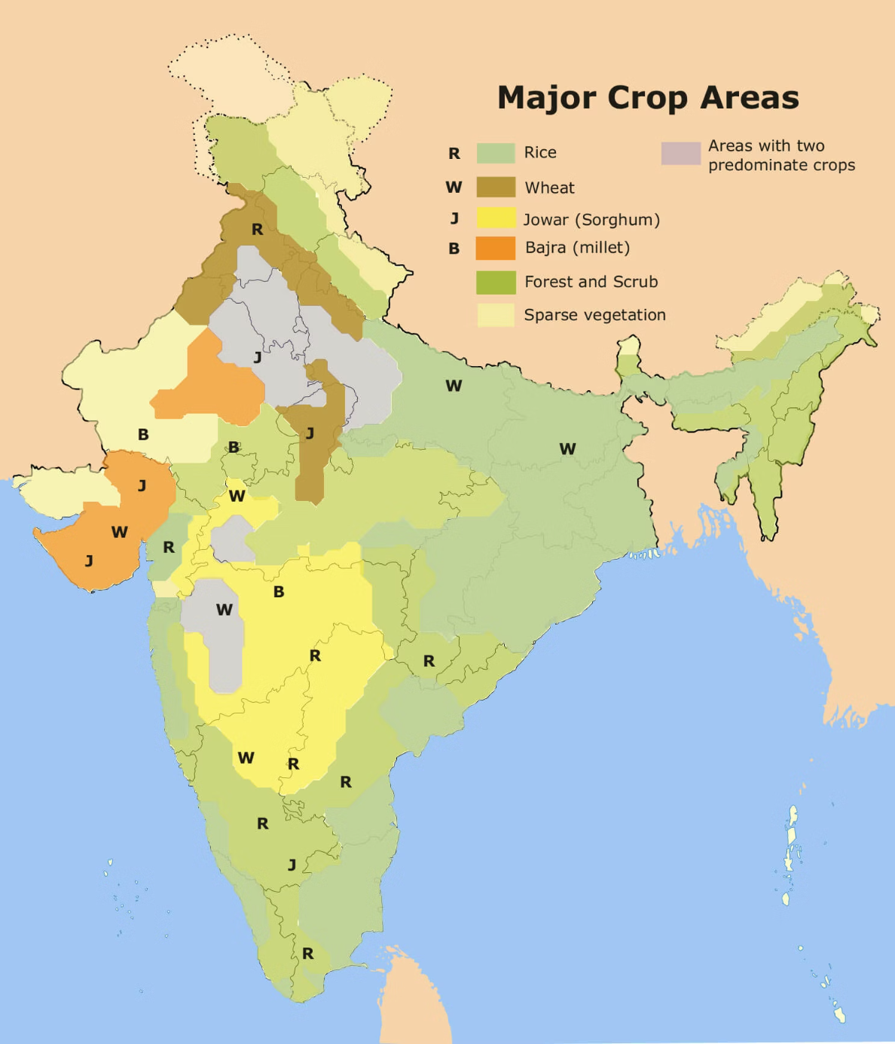
Goal 1: Closing the Local Farm Gap
The 75% Catch-Up Rule Explained
The Objective
Ensure every district achieves at least 75% of the benchmark yield established by the best-performing district in its crop category. Any district falling below this threshold is classified as an "Emergency Zone," triggering priority intervention.
Why This Works?
Achievable: 100% equality is unrealistic due to natural soil and climate variations, but 75% is a realistic stretch goal
High ROI: Raising low-performers from 30% to 75% yields the largest national gains at lowest cost
Eliminates Extremes: Focuses resources on districts where intervention has maximum impact
National Impact: Closing these gaps could boost total food output by approximately 25%, ensuring food security while stabilizing grain prices and lifting farmer incomes.

Slide 4
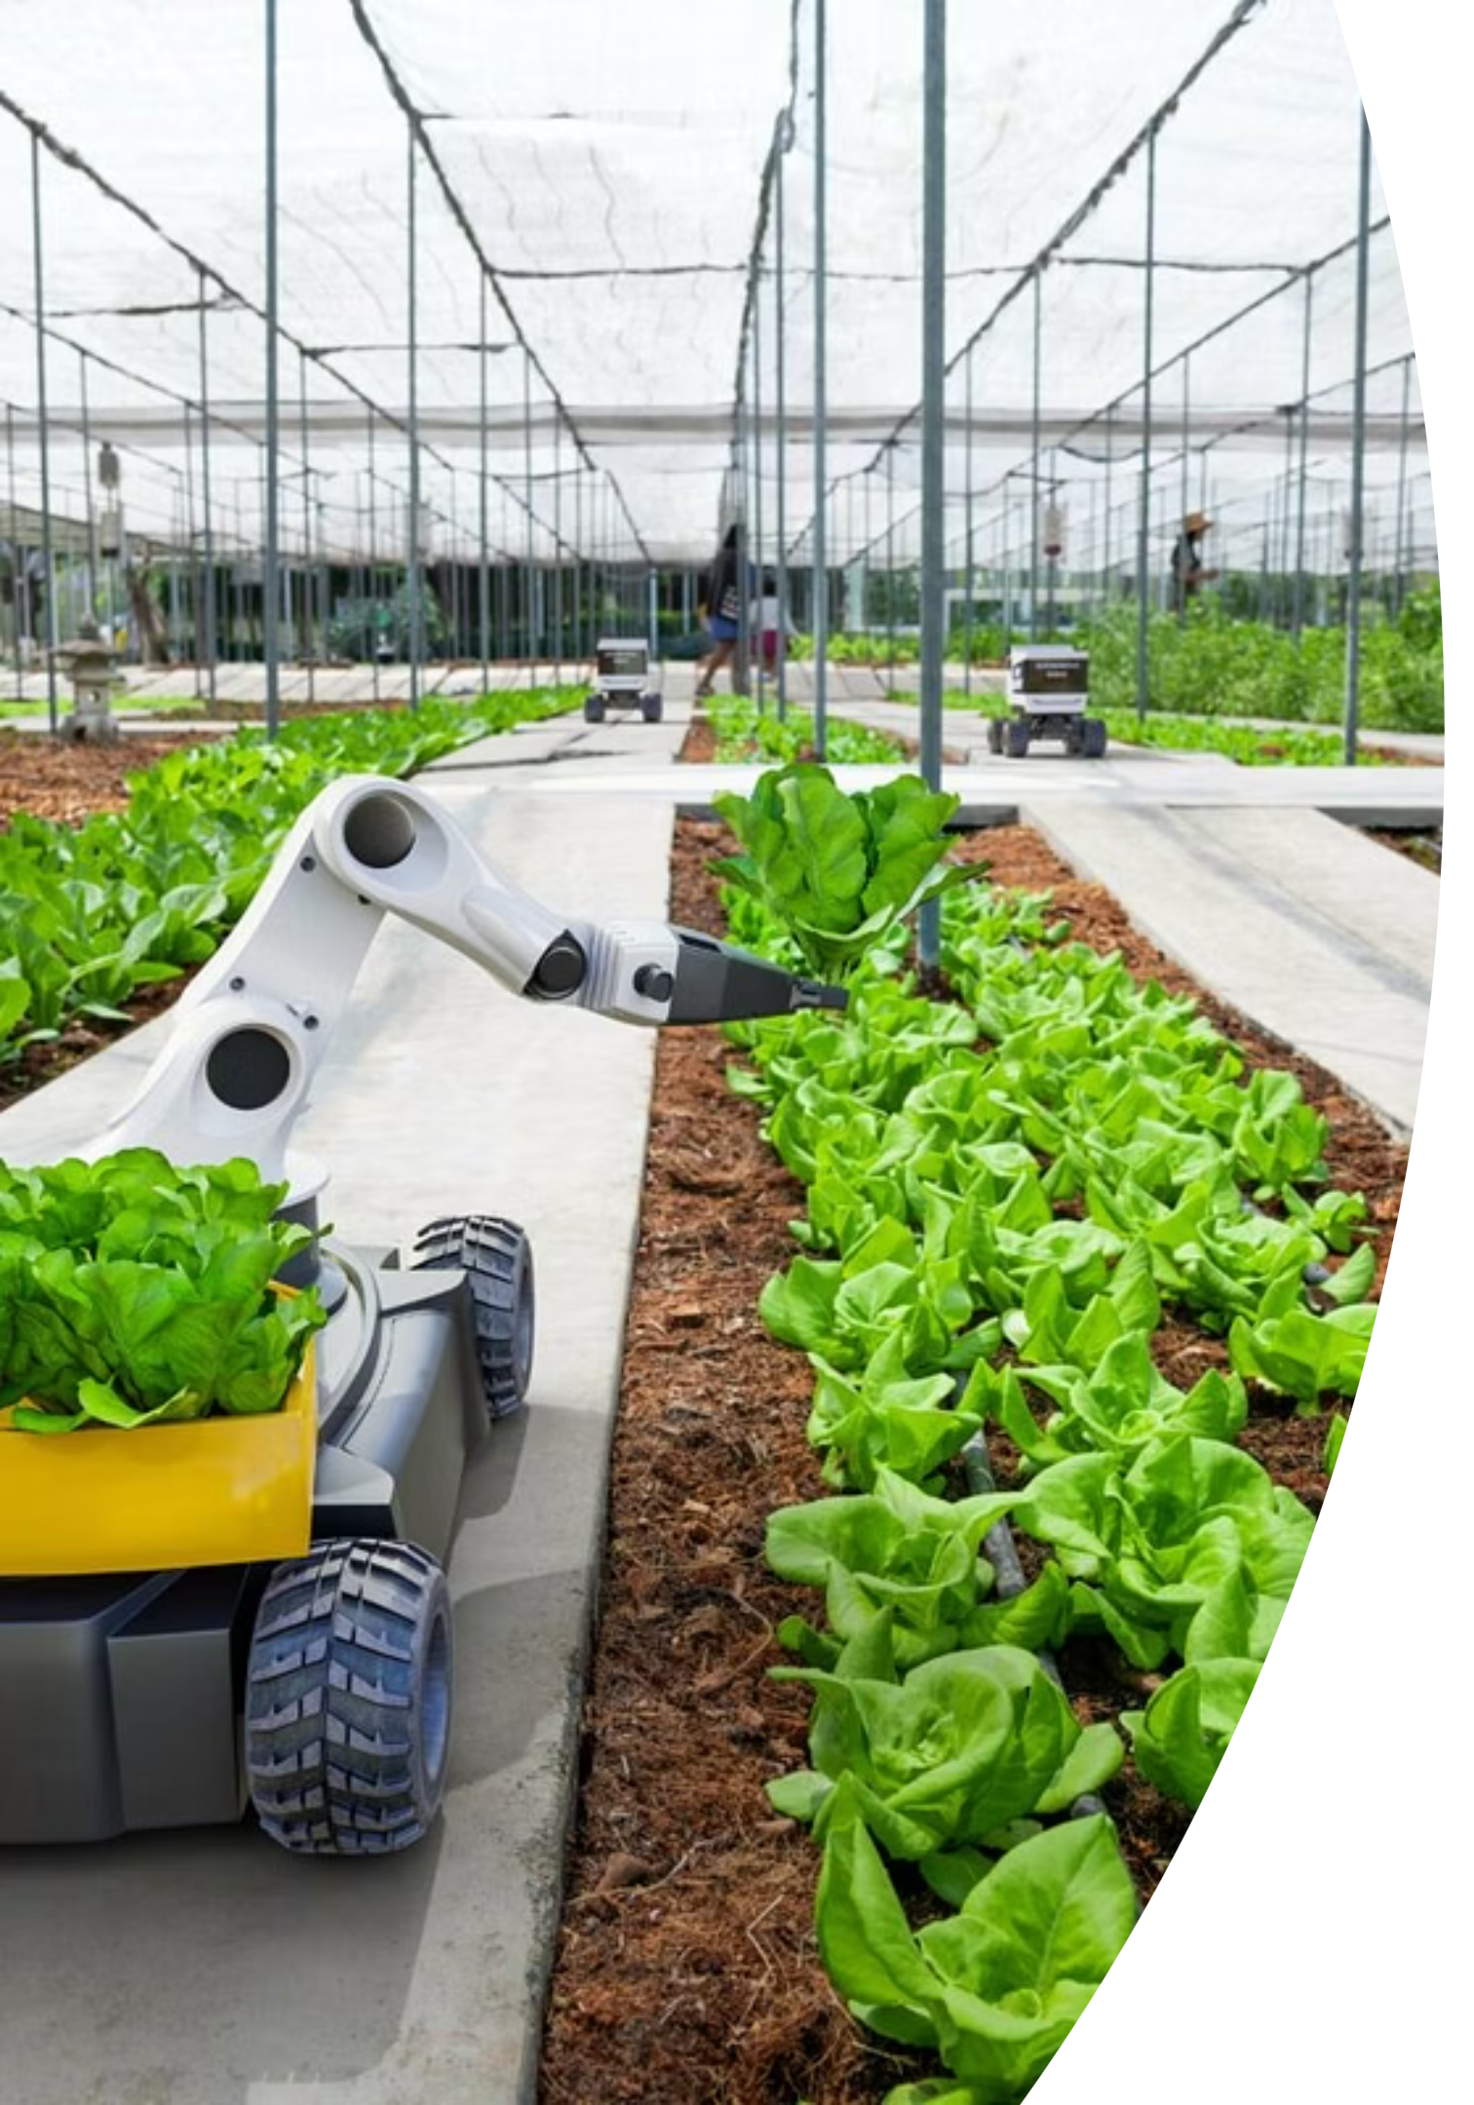
Goal 2: Demand Smarter Growth
The 60% Efficiency Mandate
This mandate ensures that agricultural growth prioritizes yield improvements over land expansion, forcing innovation and sustainable farming practices that protect India's natural resources.
What It Means
Why It Matters
At least 60% of new food production must come from efficiency gains—improved yields, better farming techniques, and technological advancement—rather than expanding cultivated area.
Land expansion threatens forests and groundwater reserves. This mandate signals that India's growth strategy prioritizes smart, sustainable agriculture over exploiting new land.
Observable Trend
Current data shows approximately 60% of production growth now comes from yield improvements, with states like Punjab demonstrating that smaller cultivation areas with higher yields outperform larger but less efficient states.

Slide 5
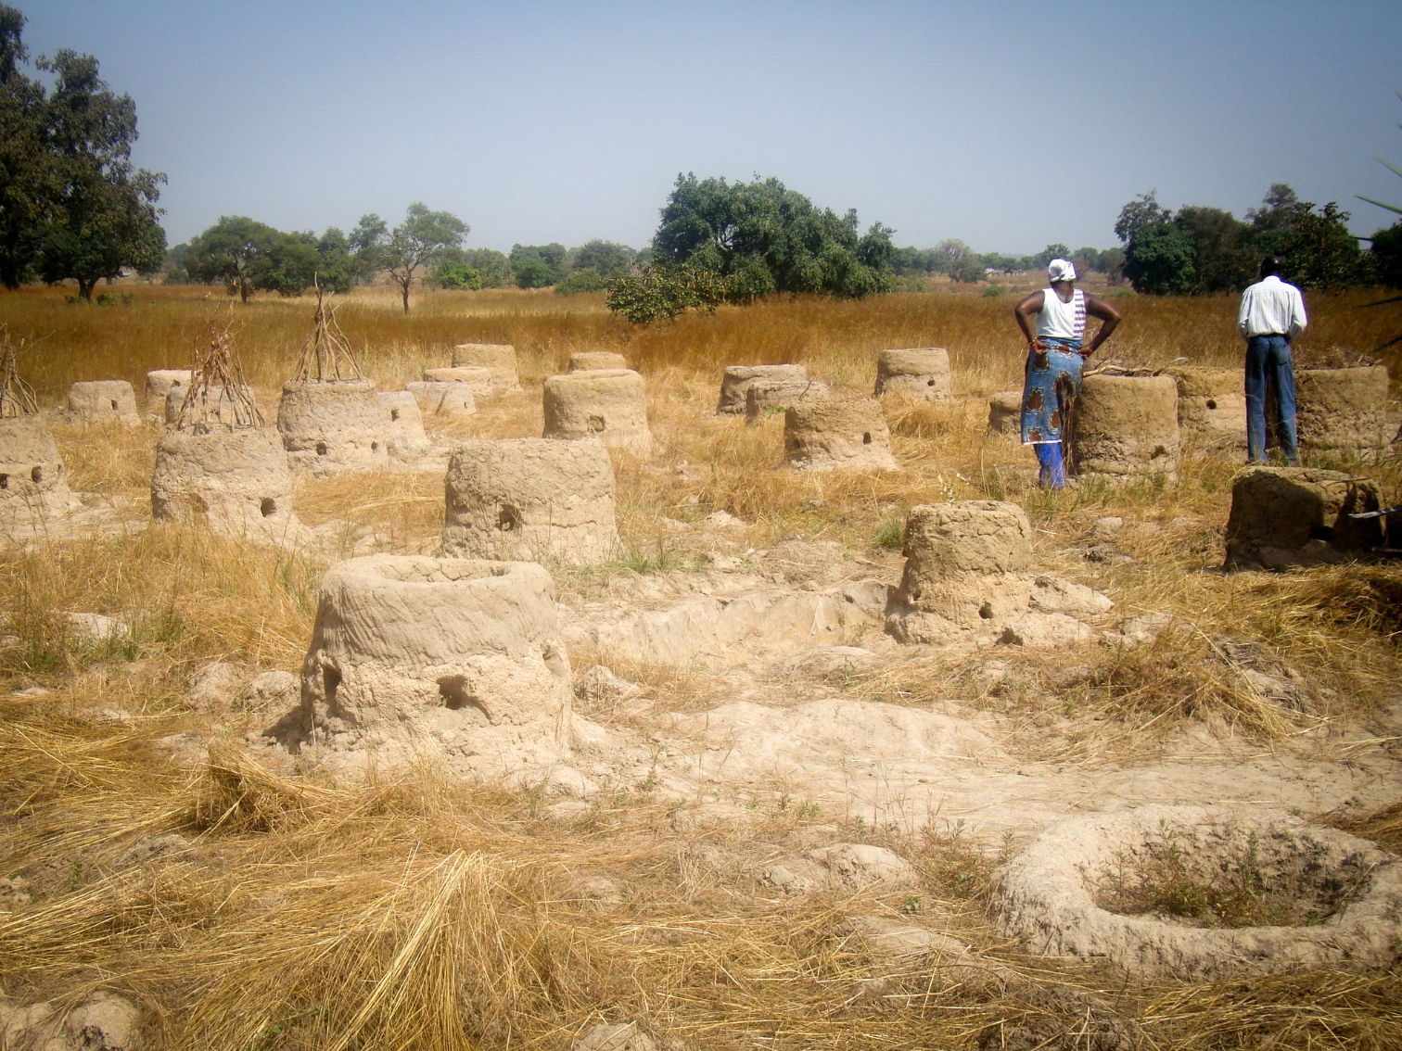

Goal 3: Fix the Big Waste Zones
The Strategic Land Check Framework
Large tracts of farmland operate significantly below their productivity potential. The Strategic Land Check identifies these "waste zones"—high-area regions with disproportionately low yields—and demands a clear decision path.
Decision Path for Waste Zones
1
Fix It
Massive intervention including high-yield variety seeds, micro-irrigation infrastructure, soil enhancement, and farmer training programs
2
Repurpose It
Redirect land toward higher-value crops, pulses, oilseeds, or alternative uses like solar farming for energy generation
Critical Finding: Rice and wheat occupy over 70% of total cultivated area. Identifying underperforming tracts within these categories and redirecting them can unlock substantial productivity gains and reduce resource wastage.

Slide 6
Data understanding and cleaning summary
Transforming Raw Agriculture Data into Policy Insights
The analysis integrates comprehensive agricultural data across Indian states and districts using three core metrics: Area (hectares), Production (metric tons), and Yield (tons per hectare).
01
02
03
Data Cleaning
Relationship Architecture
Advanced Metrics
Converted mixed formats (text, scientific notation) to numeric values. Standardized units: 1000 ha → ha, 1000 tons → tons, kg/ha → tons/ha. Removed duplicates and handled missing values systematically.
Linked fact tables to crop dimensions, geographic hierarchies (state-district), and time dimensions. Established relational integrity for multi-level analysis from national down to district level.
Created DAX measures: Total Area, Total Production, Average Yield, Area Efficiency (%), Yield Efficiency (%), and Farm Gap Index (%). These enable sophisticated performance tracking against policy targets.

Slide 7
Dashboard design and structure
Purpose:To monitor and enforce India’s Three Big Policy Objectives through data-driven visual insights — ensuring productivity, efficiency, and sustainable land use.
Goal 1 – Close the Local Farm Gap (75% Catch-Up Rule)
Objective: Identify districts performing below 75% of benchmark yield.
Map Visualization: Highlight “Emergency Zones” (districts < 75%).
KPI Cards: Average Yield (tons/ha), Farm Gap Index (%), Districts Below Target.
Bar/Column Chart: State-wise comparison of Actual vs Benchmark Yield.
Goal 2 – Demand Smarter Growth (60% Efficiency Mandate)
Objective: Measure whether yield growth outpaces area expansion.
Dual-Axis Chart: Year-wise trend of Area Growth % vs Yield Growth %.
Pie/Donut Chart: Share of growth driven by Yield vs Area.
KPI Card: Efficiency Ratio = Yield Growth / Total Growth
→ Insight: If < 60%, trigger policy review for inefficient programs.
Goal 3 – Fix Big Waste Zones (Strategic Land Check)
Objective: Detect high-area, low-yield farms wasting potential resources.Scatter Plot:
Area (ha) vs Yield (tons/ha) to locate waste zones.
Treemap: Crop distribution by state to reveal concentration.
Table/Matrix: List of top 10 districts with largest “waste zones.
”→ Impact: Enables quick decision between “Fix It” or “Repurpose.

Slide 8
Key Insights & Strategic Implications
Analysis of state and district-level performance reveals critical patterns that guide resource allocation and policy emphasis.
Yield Gap Severity
Finding: Major yield gaps persist—many districts remain below 75% of benchmark. Punjab and Haryana exceed 90%, while central and eastern states lag significantly.
1
Implication: Districts like Odisha or Bihar could increase rice yield from 4,000 to 6,000 kg/ha by adopting practices from benchmark districts, boosting national output by ~20%.
Efficiency Transition Visible
Finding: Approximately 60% of production growth now derives from yield improvements, reaching near-target levels. However, states like MP and Chhattisgarh still expand area with weak yield gains.
2
Implication: Replicating Punjab's model—high yield, smaller area—across inefficient states can boost national output without environmental stress.
Crop Concentration Risk
Finding: Rice and wheat dominate (>70% of total area), creating concentration risk. High-area, low-yield zones waste significant resources and lack diversification.
3
Implication: Redirecting 1 lakh hectares of underperforming cereal land toward pulses, oilseeds, or commercial crops can double productivity while building farmer resilience.

Slide 9
Recommended Actions for Impact
The dashboard enables targeted interventions that address specific district and crop performance patterns. These recommendations prioritize high-ROI actions aligned with the three policy objectives.
Bridge Yield Gaps
Shift to Yield-Led Growth
Deploy HYV seeds, micro-irrigation, and farmer training in districts <75% of benchmark. Example: Raising eastern rice yields by 2,000 kg/ha adds 20% to national output while stabilizing prices and farmer income.
Invest in precision farming, soil management, and agri-tech adoption. Smaller high-yield farms outperform larger inefficient ones. Scaling this model protects groundwater while boosting productivity.
Optimize Waste Zones
Strengthen Data Governance
Target high-area, low-yield zones for intervention or diversification. Redirecting underperforming land toward pulses, oilseeds, or solar farming can double productivity and reduce input wastage significantly.
Use real-time dashboard monitoring to detect yield anomalies, track efficiency ratios, and trigger evidence-based policy responses. Early detection enables faster subsidy optimization and targeted farmer support.

Slide 10
Conclusion: From Data to Transformation
Overall Insight:The Power BI dashboard reveals major variations in crop yield, area, and production efficiency across states and years — highlighting both progress and problem zones.
🔹 Key Findings:
Certain states show high production but low yield, signaling inefficient land use.
Emerging crops are driving growth in several regions, while others show decline.
Large low-yield zones (“Big Waste Zones”) need urgent intervention or crop diversification.
🔹 Learning Outcomes:
Understood how visual analytics can identify policy gaps and guide interventions.
Developed ability to link data insights with strategic agricultural goals (75% rule, 60% efficiency mandate).

Slide 11


